Slide 1
Cyber Scanning
Chien-Chung Shen
cshen@udel.edu

Slide 2
Organization

Slide 3
Nature of Cyber Scanning
Active scanning - identify network services by transmitting probe packets and subsequently monitoring their responses
Passive scanning – identify network services by observing traffic generated by clients and servers

Slide 4
Active Scanning (1)
Process of of identifying network services by transmitting probe packets towards network hosts and devices and subsequently monitoring their responses
Typically employed by malicious adversaries to probe a network for certain vulnerabilities
Also has a legitimate - allowing network operator to discover open services in the network in an attempt to check those for known vulnerabilities
Probe packets could be either generic, targeting a specific protocol (e.g., TCP 3-way handshake) or targeted, focusing on a precise application (e.g., services operating on well-known ports)
Passive scanning

Slide 5
Active Scanning (2)
Drawbacks
  only verify the readiness to open a TCP connection and not what service is supported by the connection; hence misinterpret services running on non standard ports
  fails to classify services that have no standard ports, or those that use dynamic port assignment such as services utilizing the remote procedure call (RPC) protocol
UDP probing
Indirectly infer the presence of a UDP service by the lack of a negative response (no news is good news)
many hosts automatically generate ICMP port unreachable messages when no process is listening to a given UDP port

Slide 6
Active Scanning (3)
Example: operating system (OS) fingerprinting
  remotely determine the operating system (type and version) of a particular host of interest
  responses to sequences of probe packets form a signature or a fingerprint for the remote OS that can be compared against a signature database of known OS versions
  OS fingerprinting takes advantage of the observation that each OS’ network stack has slight variations in the way it responds to certain packets
Example: application fingerprinting
  The initial text sent by servers during a connection attempt is known as a banner
  Software versions advertised in application banners can identify potential security issues if it is determined that the software version contains known vulnerabilities

Slide 7
Passive Scanning (1)
Identify network services by observing traffic generated by clients and servers as it passes an observation point
Hardware tap (e.g., optical splitter) or software tool (e.g., Wireshark)
For TCP, needs to capture TCP connection setup messages - completion of three way handshake indicates that a service is available
Neither (active or passive) can identify services that do not run on well-known ports

Slide 8
Passive Scanning (2)
Example: Passive Asset Detection System (PADS)
  signature-based software to passively detect network assets using application fingerprinting
  provide an accurate and current listing of the hosts and services offered on the network by utilizing TCP, ARP, and ICMP protocols to perform signature matching

Slide 9
Pros and Cons of Active Scanning
Pros
Provides a comprehensive report of all open and unprotected ports at the time of the probing
It will not detect ports that are filtered by firewalls or obscured by mechanisms such as port knocking
performs very fast
Cons
very intrusive
Can be detected and logged by host or intrusion detection systems
Does not identify hosts that may be temporarily unavailable at the time of the scan

Slide 10
Pros and Cons of Passive Scanning
Pros
non-intrusive, not detected by communicating parties
Better detect active services running on transient hosts (hosts that frequently powered off, e.g., laptops)
Can detect services that active probing misses because of firewall configurations
Provide insights into trends and other behaviors which active probing cannot
While monitoring servers, passive monitoring can also track clients, providing extra information such as server popularity and server load
consumes no network resources; can be run on a long-term basis
Cons
Only detects services that are active; silent servers go unmonitored

Slide 11
Organization

Slide 12
Cyber Scanning Strategies
remote to local scanning
local to remote scanning
local to local scanning
remote to remote scanning
The first three classes take into consideration the boundaries of a specific enterprise network and define the direction of the cyber scanning activity
Such activity can be generated by a diverse number of hosts, targeting a number of hosts, and using various cyber scanning methods and techniques

Slide 13
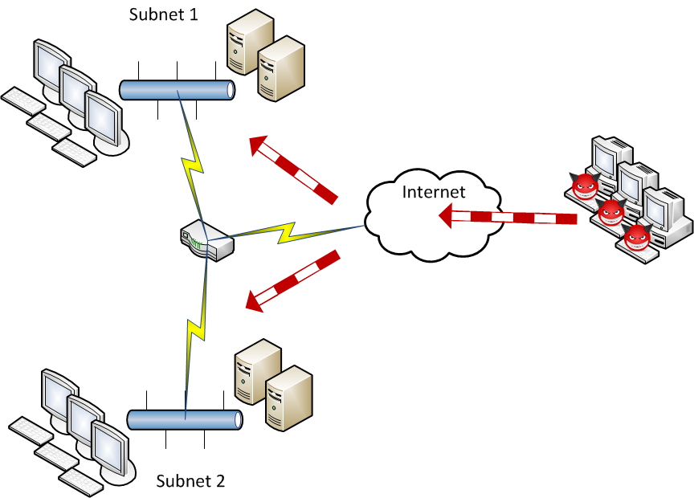
Cyber Scanning Strategies
A remote host, outside the boundary of a specific network, performing scanning on a host inside the enterprise network
Most worrisome for enterprise network administrators as they attempt to protect their IT infrastructure from unknown external adversaries

Slide 14
Cyber Scanning Strategies
scanning host performs network reconnaissance against external systems
may cause serious legal issues against the enterprise network since its infrastructure would be used for malicious purposes against Internet systems

Slide 15
Cyber Scanning Strategies
Host scans systems within the boundaries of the enterprise network in which it resides

Slide 16
Cyber Scanning Strategies
Remote to remote scanning does not depend on certain boundaries
Defined as world wide cyber scanning campaigns
Rather than focusing on a specific enterprise network as a target, this strategy aims at probing and sequentially exploiting the Internet’s services
This strategy is often distributed, possesses sophisticated stealth capabilities and is typically highly coordinated
Recent cyber scanning campaigns

Slide 17
Organization

Slide 18
Cyber Scanning Approaches
Aim
Wide range scanning
  rapid scanning of large blocks of Internet addresses in the search for a specific service or vulnerability
  little human interaction in this type of reconnaissance
  e.g., auto-rooters - composite tools that augment basic port scanning functionality by launching an attack as soon as an open port is located on a target system; they are often used for the rapid enrollment of vulnerable systems into botnets
  e.g., worm propagation - indiscriminately probing the Internet as rapidly as possible to locate and infect vulnerable systems

Slide 19
Cyber Scanning Approaches
Aim
Target-specific scanning
  stealthy, focused scan-ning of a predetermined target host or network
  Indirect scanning: an attacker uses some systems to scan a target and other systems to attack the same victim; if the scanning activity from the scanning system is detected, the attacker simply uses another scanning system
  Botnet scanning: a collection of compromised systems (bots or zombies) are used to scan a target
  Low and slow scanning: an attacker slowly scans a target host or network (taking days, weeks or months); slow scans may blend into the network noise never exceeding detection thresholds or exhausting detection system state
Method
Single source scanning
Distributed scanning

Slide 20
Cyber Scanning Approaches
Method
Single source scanning
  operates from a one (source) to many (targets) fashion
  vertical scan - consists of a port scan of some or all ports on a single computer
  horizontal scan – scans a single port across multiple IP addresses
  strobe scan - port scan of multiple ports across multiple IP addresses
  block scan - port scan against all ports on multiple IP addresses
Distributed scanning
  multiple systems act in a union strategy to scan a network or host of interest
  reduces the scanning footprint of any single system and thus decreases the likelihood of being detected

Slide 21
Summary
Active scanning is efficient but is very intrusive
Passive scanning is less intrusive, works well in the presence of firewalls and is optimized to operate effectively with transient hosts
Cyber scanning strategies include remote to remote scanning also known as cyber scanning campaigns. The latter possess sophisticated stealth capabilities and are typically highly coordinated
Botnet scanning is both a target-specific and a distributed cyber scanning method

Slide 22
Cyber Scanning Techniques
Classified based on exchanged messages and scanning abilities

Slide 23
Open Scan
Aka vanilla scan following the same TCP 3-way handshake connection
Use a normal TCP connection to determine if a port is available
Use connect() call
easily detected by a firewall
Visible in connection logs
Since open scan requires the completion of a TCP connection, normal application processes immediately follow
By the time RST is received, application initiation process is already well underway and system resources have been used
closed port
open port

Slide 24
Half-Open Scan
Aka TCP SYN scan: gather information about open ports without completing the TCP handshake process
When an open port is identified, the TCP handshake is reset before it can be completed
not logged by destination applications - stealthier than open scan and less visible in the destination systems’ application logs
less stressful to application service because it does not force the application to initialize or for systems resources to be allocated
Need to create raw packet
closed port
open port

Slide 25
Version Detection Scan
If open ports are found, Version Detection scan will begin the probing process by directly communicating with the remote applications on the open ports to uncover as much information as possible
requires significant processing power and elevated networking bandwidth since it needs to probe all the services and consequently transmit all their information
its activity is usually written in application logs which makes it less stealthier

Slide 26
Cyber Scanning Techniques
Classified based on exchanged messages and scanning abilities

Slide 27
Stealth Scan – SYN/ACK
Scans using SYN flag to investigate open ports are easily detected and logged by intrusion detection systems
avoid filtering devices by employing certain sets of flags other than SYN to appear as legitimate traffic
Resort to inverse mapping to determine open ports
SYN/ACK Scan
For a closed port, the target will reply with a RST flag
For an open port, no response (due to the fact that TCP requires a sole SYN flag to initiate a connection)
Due to packet loss, false positives
closed port
open port

Slide 28
Stealth Scan - IDLE
exploits IP fragmentation identification sequences and IP address spoofing
gathering port information using another station (the zombie) where the scanning process appears as it has been initiated by the zombie IP address instead of the actual source station
Two requirements of zombie machine
  zombie host must be idle to ensure that IP identification frames will remain consistent throughout the duration of the scan
  zombie host must provide consistent and predictable IP identification (IPID)

Slide 29
Stealth Scan - IDLE
source sends a SYN/ACK to zombie host expecting RST as a response containing IPID
source executes a Half-Open scan, using the spoofed IP address of the zombie, targeting the destination host
If port is open, destination will reply to zombie with SYN/ACK. The zombie, not expecting a SYN/ACK since it never sent a SYN, will reply by a RST and increase its IPID
The original host resends the initial SYN/ACK probe to the zombie station. If IPID has been incremented, the source will infer that the port that was spoofed in the original SYN is open on the destination target; otherwise, the port is closed

Slide 30
Stealth Scan –FIN/Xmas Tree/Null
send a single frame to a TCP port without any TCP handshaking or any additional packet transfers
  FIN – FIN flag
  Xmas Tree – URG/PUSH/FIN flags (00101001)
  Null – empty flags
Closed port – reply RST
Open port – none
Since no TCP sessions are created, none of these scans should appear in any of the application logs
ineffective when used against Microsoft machines as all ports will appear to be closed regardless of their actual state
  any device showing open ports must not be a Windows device
closed port
open port

Slide 31
Cyber Scanning Campaigns

